Slide 1
Personality
Anoosha Rehan, Lecturer, FAST NUCES CFD

Slide 2
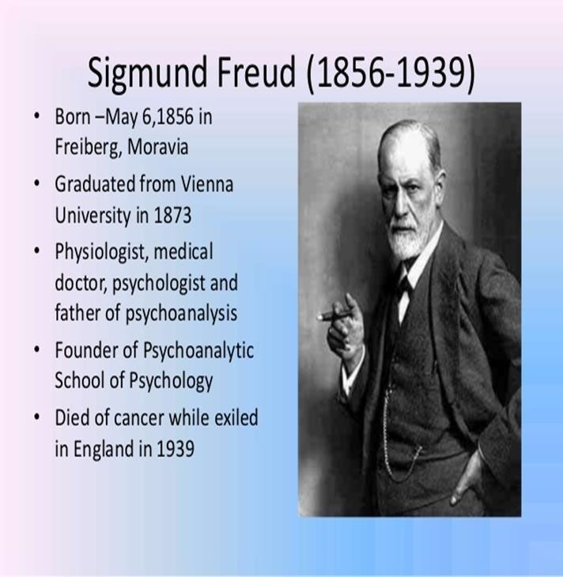
Psychoanalytic Theory of Personality

Slide 3
Psychoanalytic Theory of Personality
Fathered by Sigmund Freud.
Idea of the Libido (survival energy): driving force of all the behavior.
Proposed the concept of Instincts:
Eros (life instinct)
Thanatos (death instinct)

Slide 4
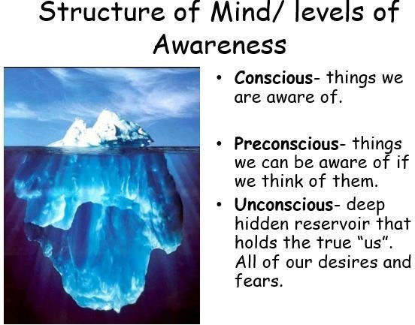
Structure of Mind / Levels of Awareness

Slide 5
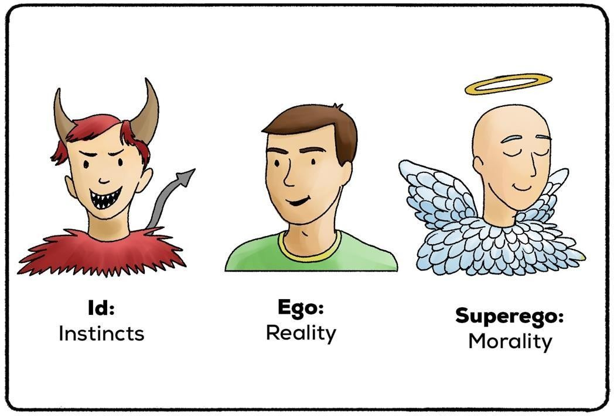
Freud’s Concept of Personality: Structure and level of personality
Id
Ego
Superego

Slide 6
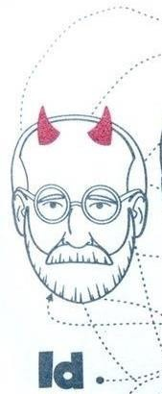
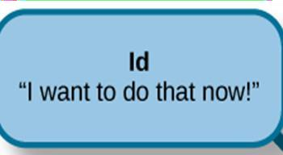
The id operates according to the pleasure principle in which the goal is the immediate reduction of tension and the maximization of satisfaction.

Slide 7
Id:
Energy striving to satisfy basic drives.
Exists entirely in the unconscious so we are never aware of it (but its influence can indirectly manifest in conscious thoughts and behaviors).
Works on the pleasure principle.
Avoids pain and receives instant gratification.

Slide 8
Ego:
Develops after the Id works on the reality principle.
Negotiates between the Id and the environment.
In our conscious and unconscious minds.
It is what everyone sees as our personality.

Slide 9
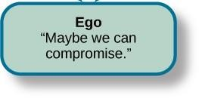
Ego:
In a sense, then, the ego is the “executive” of personality: it makes decisions, controls actions, and allows thinking and problem solving of a higher order than the id’s capabilities permit.

Slide 10
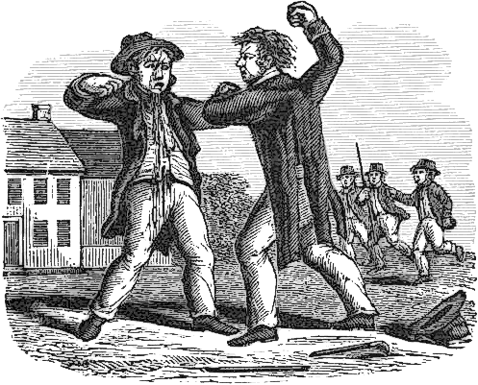
Ego:
Example: If an individual seriously wants to harm his foe in order to take revenge. His id says just take the revenge, but his ego does not want to end up in jail or face any serious consequences. So the person decides to stay out.

Slide 11
Superego:
The superego is the final personality structure to develop in childhood. According to Freud, the superego is the part of personality that harshly judges the morality of our behavior. It represents the rights and wrong of society as taught and modeled by a person’s parents, teachers, and other significant individuals.

Slide 12

Superego:
The superego includes the conscience, which prevents us from behaving in a morally improper way by making us feel guilty if we do wrong. The superego helps us control impulses coming from the id, making our behavior less selfish and more virtuous.

Slide 13
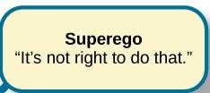
Superego:
Develops at the age of about 5.
It is our conscience (what we think the difference is between right and wrong).
The ego often mediates between the superego and id.

Slide 14
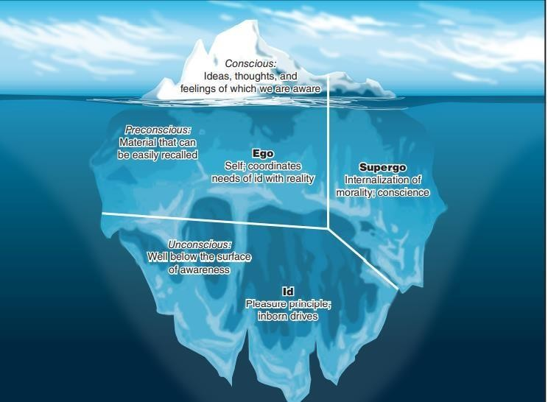

Slide 15
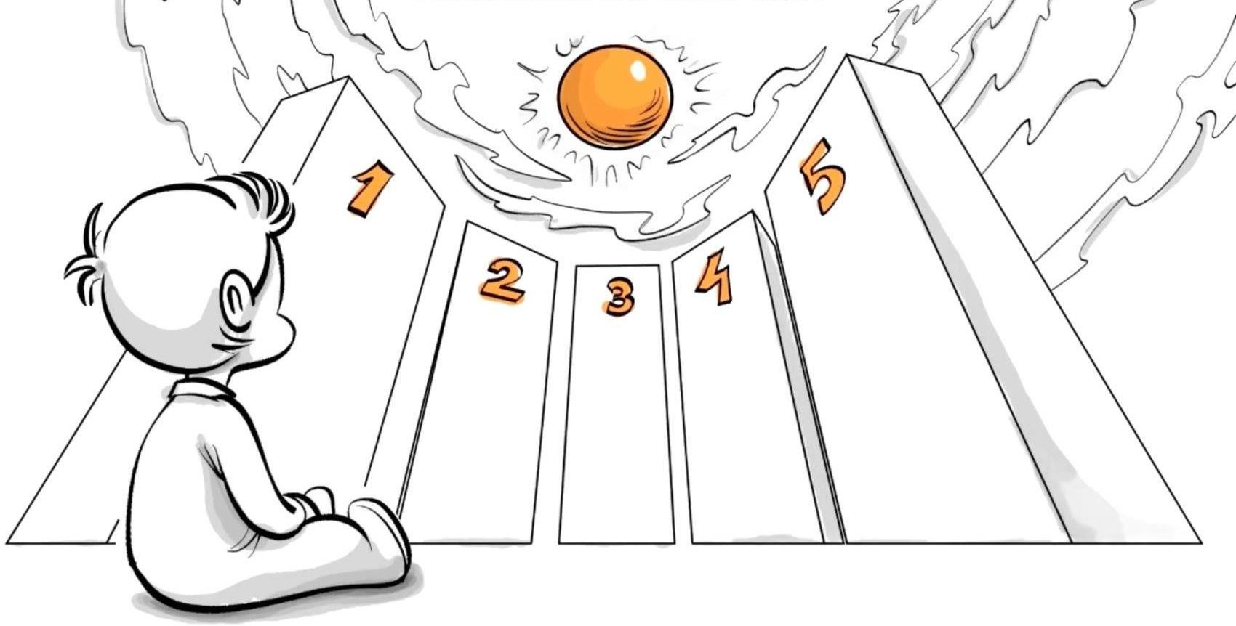
Freud’s psychological stages of Development
Stages of psychological development:
Oral
Anal
Phallic
Latency

Slide 16
According to Freud, if we are not able to resolve the conflicts that occur at a particular psychological stage, we may become locked in that conflict throughout life—something he called fixation. Fixations are conflicts or concerns that persist beyond the developmental period in which they first occur. Such conflicts may be due to having needs ignored.
A fixation is a persistent focus of the id’s pleasure-seeking energies at an early stage of psychosexual development.
Oral, anal, and phallic fixations occur when an issue or conflict in a psychosexual stage remains unresolved, leaving the individual focused on this stage and unable to move onto the next.

Slide 17
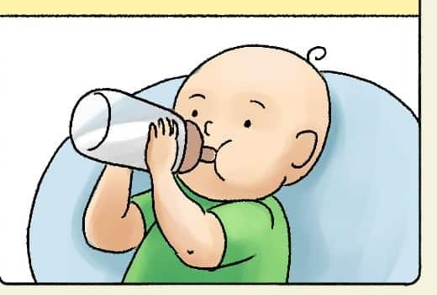
Oral Stage (birth to 1 year):
Gratification is obtained through oral route.
At this stage in life infant’s gratification is oral, or mouth such as drink milk, pacifier and put all toys in the mouth.
Freud believed oral stimulation or unmet needs could lead to an oral fixation in later life, such as smoking, nail-biting, finger-chewing, and thumb sucking.
Oral personalities engage in such oral behaviors, particularly when under stress.

Slide 18
Anal (1-3 years):
Conflict between child’s ability to eliminate wastes at will versus societal expectations of toilet training.
At this point, the major source of pleasure changes from oral to anal region and children obtain considerable pleasure from both retention and expulsion of feces. If toilet training is particularly demanding, fixation might occur.
If a child experiences excessive control and pressure during toilet training, they might become fixated at the anal stage. As adults, they may exhibit characteristics of excessive orderliness, punctuality, rigidity, and a need for control—or extreme disorderliness and sloppiness in adulthood.

Slide 19
Phallic stage (3-6 years):
Oedipus complex:
Essentially, a boy feels that he is attached with his mother.
Electra complex:
A girl feels that she is attached to her father.
Fixation: In adulthood, this might manifest as difficulties in forming healthy romantic relationships

Slide 20

Latency (6-12 years):
Focus on internalization of society’s rules. Freud thought that during the latent Stage, focus is towards school work, hobbies and friendships.
In this stage, children develop social skills and find comfort in family and peer interactions.
Much of the child's energy is channeled into developing new skills and acquiring new knowledge.
While fixation is less common during this stage, unresolved conflicts related to earlier stages can still affect development.

Slide 21
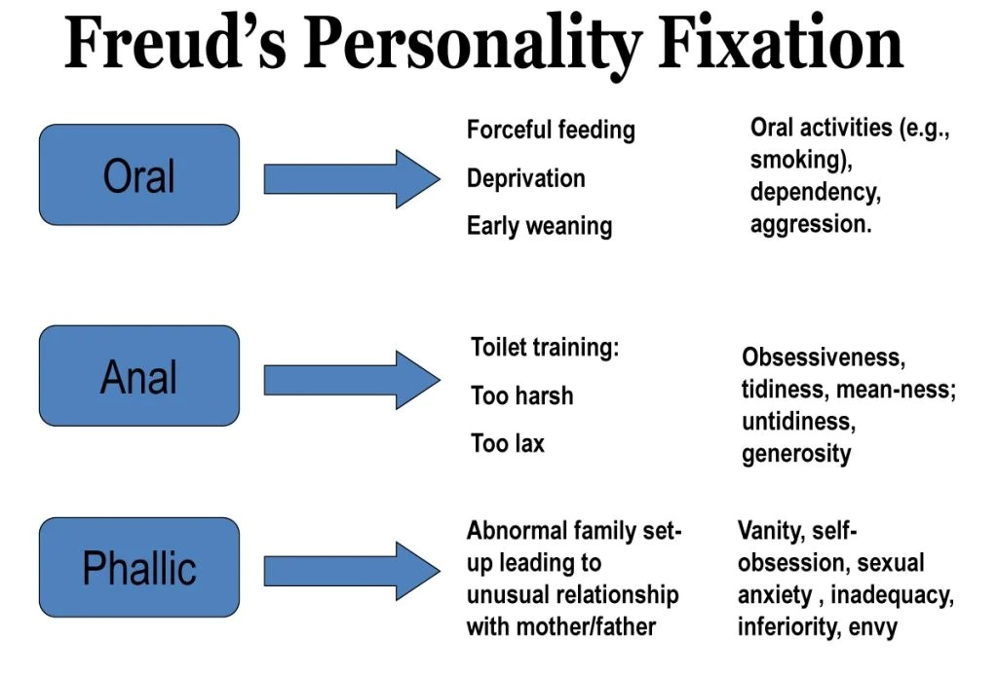

Slide 22
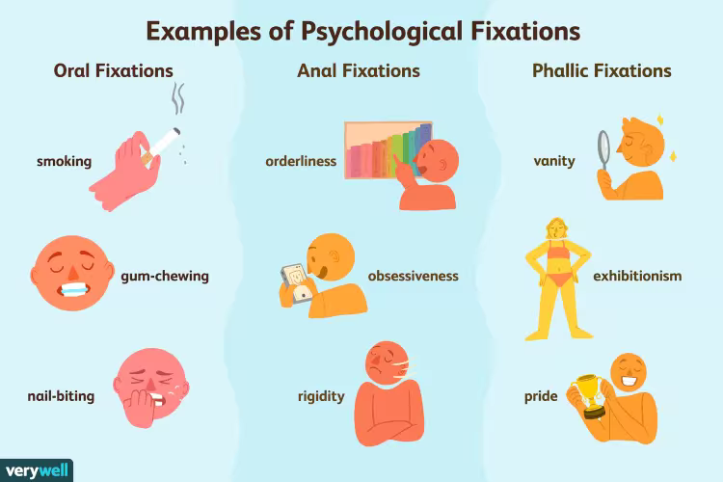

Slide 23
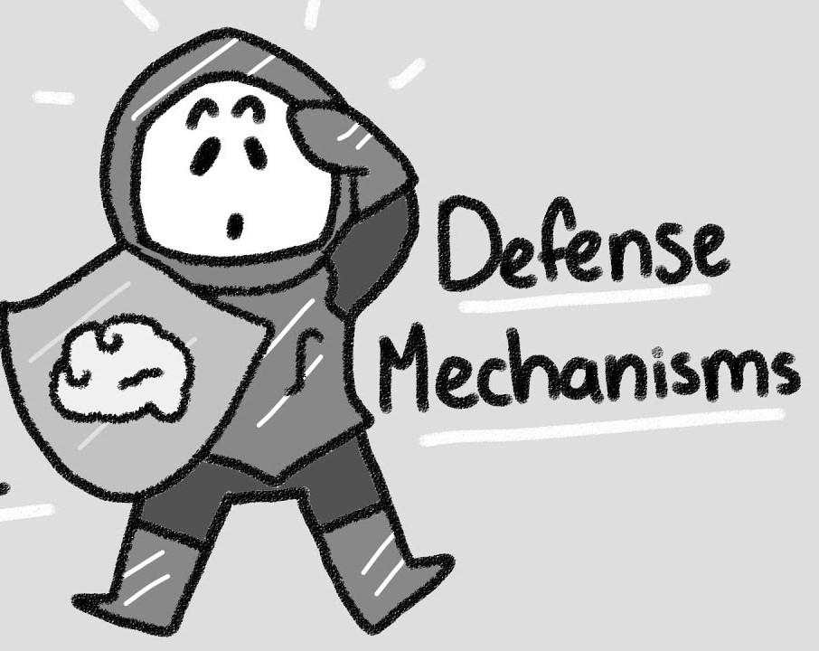
Defense Mechanisms
The ego has a pretty important job and that is to protect you from threatening thoughts in our unconscious.
One way it protects us is through defense mechanisms.
You are usually unaware that they are even occurring.

Slide 24
Repression
We deliberately and consciously try to push away thoughts into our unconscious.
Sometimes it is called Motivated Forgetting.
Being abused as a child but not remembering the abuse.

Slide 25
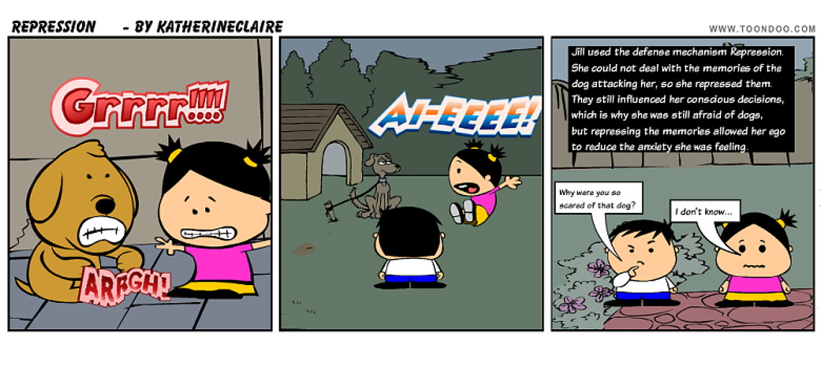

Slide 26
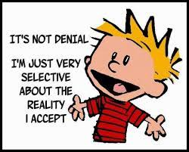
Denial:
Not accepting the ego-threatening truth.
Individual will refuse to accept the reality.
You completely reject thoughts and feelings that cause you anxiety.
A person with a smoking problem may repeatedly deny that they have an issue, even when confronted with evidence of their chain smoking.

Slide 27
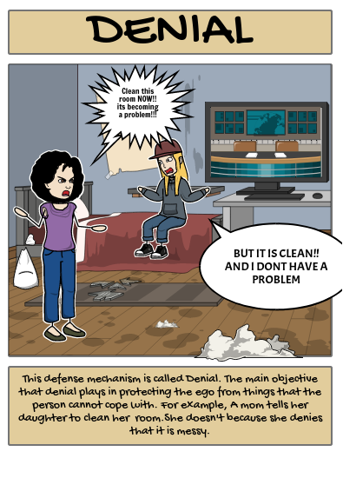

Slide 28
Displacement:
Redirecting one’s feelings toward another person or object.
Often displaced on less threatening things.
After a difficult day at work, a person might come home and take out their frustration on a family member or household object rather than addressing the issues at work.

Slide 29
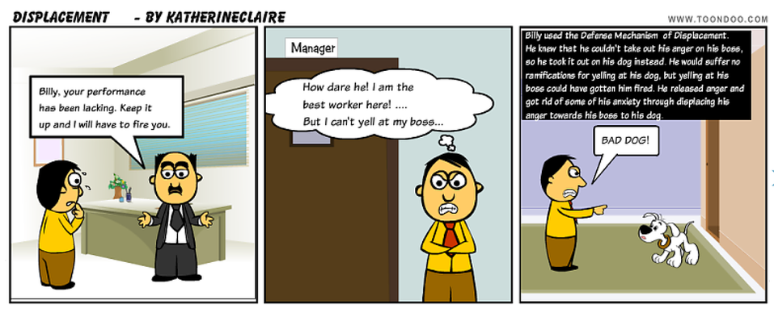

Slide 30
Projection:
Believing that the feelings one has toward someone else are actually held by the other person and directed at oneself.
Projection involves attributing one's unacceptable thoughts, feelings, or qualities to others.
Someone who is secretly envious of a coworker might accuse the coworker of being jealous of them, projecting their own feelings onto the other person.
Feeling attracted to someone other than your spouse, then fearing that your spouse is cheating on you

Slide 31
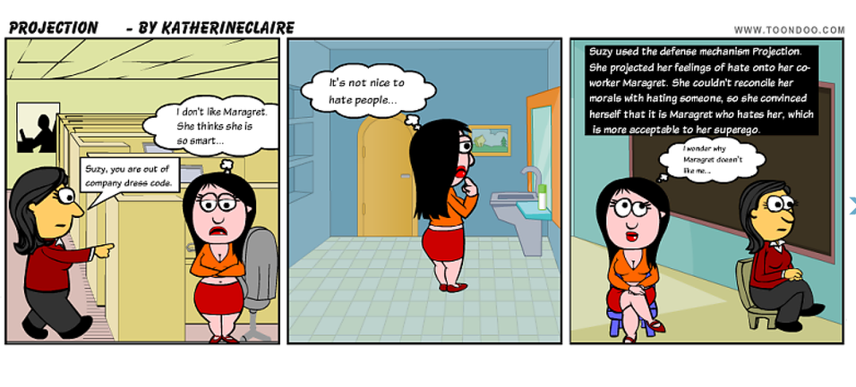

Slide 32
Reaction Formation
Expressing the opposite of how one truly feels.
Unconscious impulses are expressed as their opposite in consciousness.
Someone with deep-seated anger toward a family member might go out of their way to show excessive affection and kindness to that person, masking their true anger.
Being sad about a recent breakup, but acting happy about it.

Slide 33
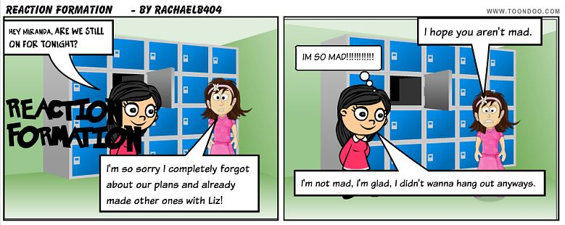

Slide 34

Rationalization
People provide self-justifying explanations, which are often untrue.
Coming up with a beneficial result of an undesirable outcome.
Justifying an unacceptable feeling or behavior with logic.
Being denied a loan for your dream house, then saying it's a good thing because the house was too big anyway.
A student who fails an exam might rationalize it by saying they didn't really want a good grade or that the test was unfair, avoiding the acknowledgment of their lack of preparation.

Slide 35
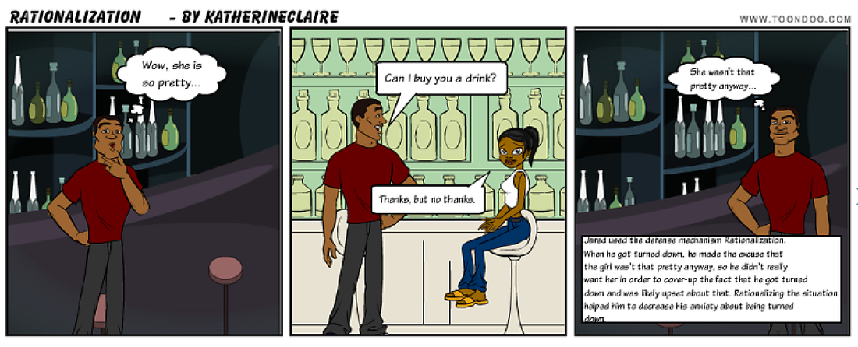

Slide 36
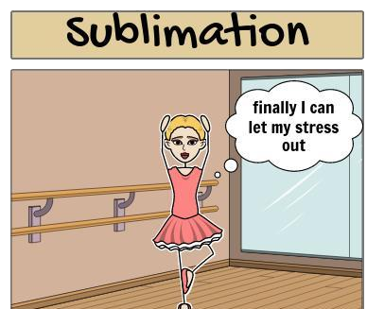
Sublimation
Acting out unacceptable impulses in a socially acceptable way.
Channeling one’s frustration toward a different goal.
Sometimes a healthy defense mechanism.
Being upset with your spouse but going for a walk instead of fighting.
A person with aggressive tendencies might become a successful competitive athlete, channeling their aggression into their sport.

Slide 37
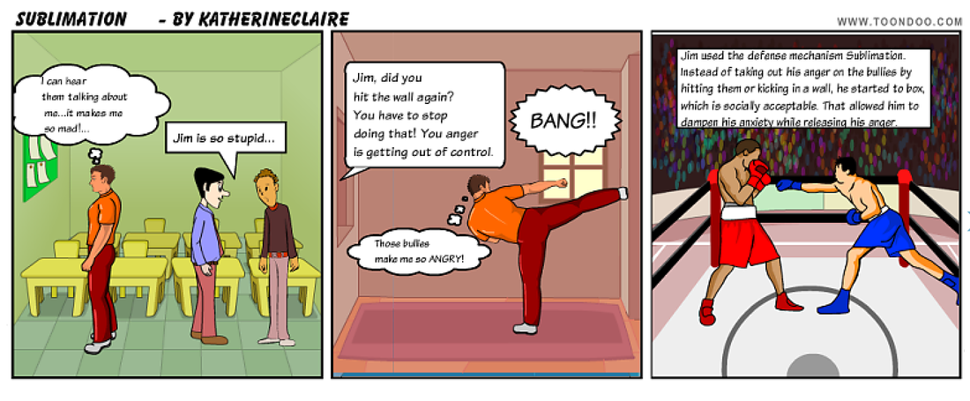

Slide 38
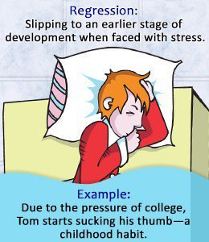
Regression
Returning to a previous immature stage of development.
This type of defense mechanism may be most obvious in young children. If they experience trauma or loss.
Hugging a teddy bear when you're stressed, like you did when you were a child.

Slide 39
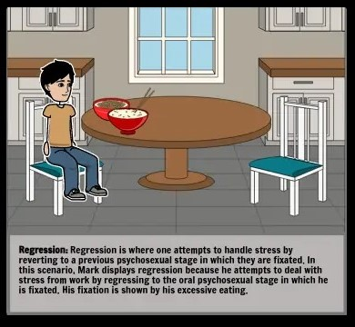

Slide 40
To deal with anxiety, Freud believed that defense mechanisms helped shield the ego from the conflicts created by the id, ego and superego.
So what happens when the ego cannot deal with the demands of our desires, the constraints of reality, and our own moral standards?
According to Freud, anxiety is an unpleasant inner state that people seek to avoid. Anxiety acts as a signal to the ego that things are not going the way they should. As a result, the ego employs some sort of defense mechanism to help reduce these feelings of anxiety.

Slide 41
These defense mechanisms are thought to be strategies the mind employs to protect the individual from emotional distress or anxiety. While they can be adaptive in moderation, an overreliance on defense mechanisms can interfere with healthy coping and self-awareness.

Slide 42
Thank you!

